Slide 1

Introduction to Data Governance
Data governance is a critical framework for managing data's availability, usability, integrity, and security across an organization. It establishes a unified approach to data sharing and quality, enabling evidence-based decision-making and ensuring regulatory compliance.

Slide 2
Why Data Governance Matters
Critical Asset
Informed Decisions
Transparency & Trust
Treat data as a core enterprise asset, vital for strategic growth.
Empower better choices and reduce operational friction through reliable data.
Ensure clarity, cut costs, and protect all stakeholders with robust governance.
Effective data governance ensures data transparency, mitigates risks, and builds trust among all stakeholders.

Slide 3




Key Pillars of Data Governance
Data Quality
Data Stewardship
Ensuring data is accurate, complete, reliable, and timely for all uses.
Assigning clear accountability and responsibility for data assets.
Data Protection & Compliance
Data Management
Adhering to regulations and implementing robust security measures.
Defining policies, processes, and lifecycle controls for all data.

Slide 4
Roles and Responsibilities
Data Consumers
Utilize data effectively and responsibly.
Data Custodians
Manage data systems and security infrastructure.
Data Stewards
Maintain data integrity and ensure compliance.
Data Owners
Accountable for the quality and use of specific data domains.
Data Governance Manager
Oversees the entire governance framework.
Each role is vital for fostering a data-driven culture and maintaining high standards of data quality.

Slide 5
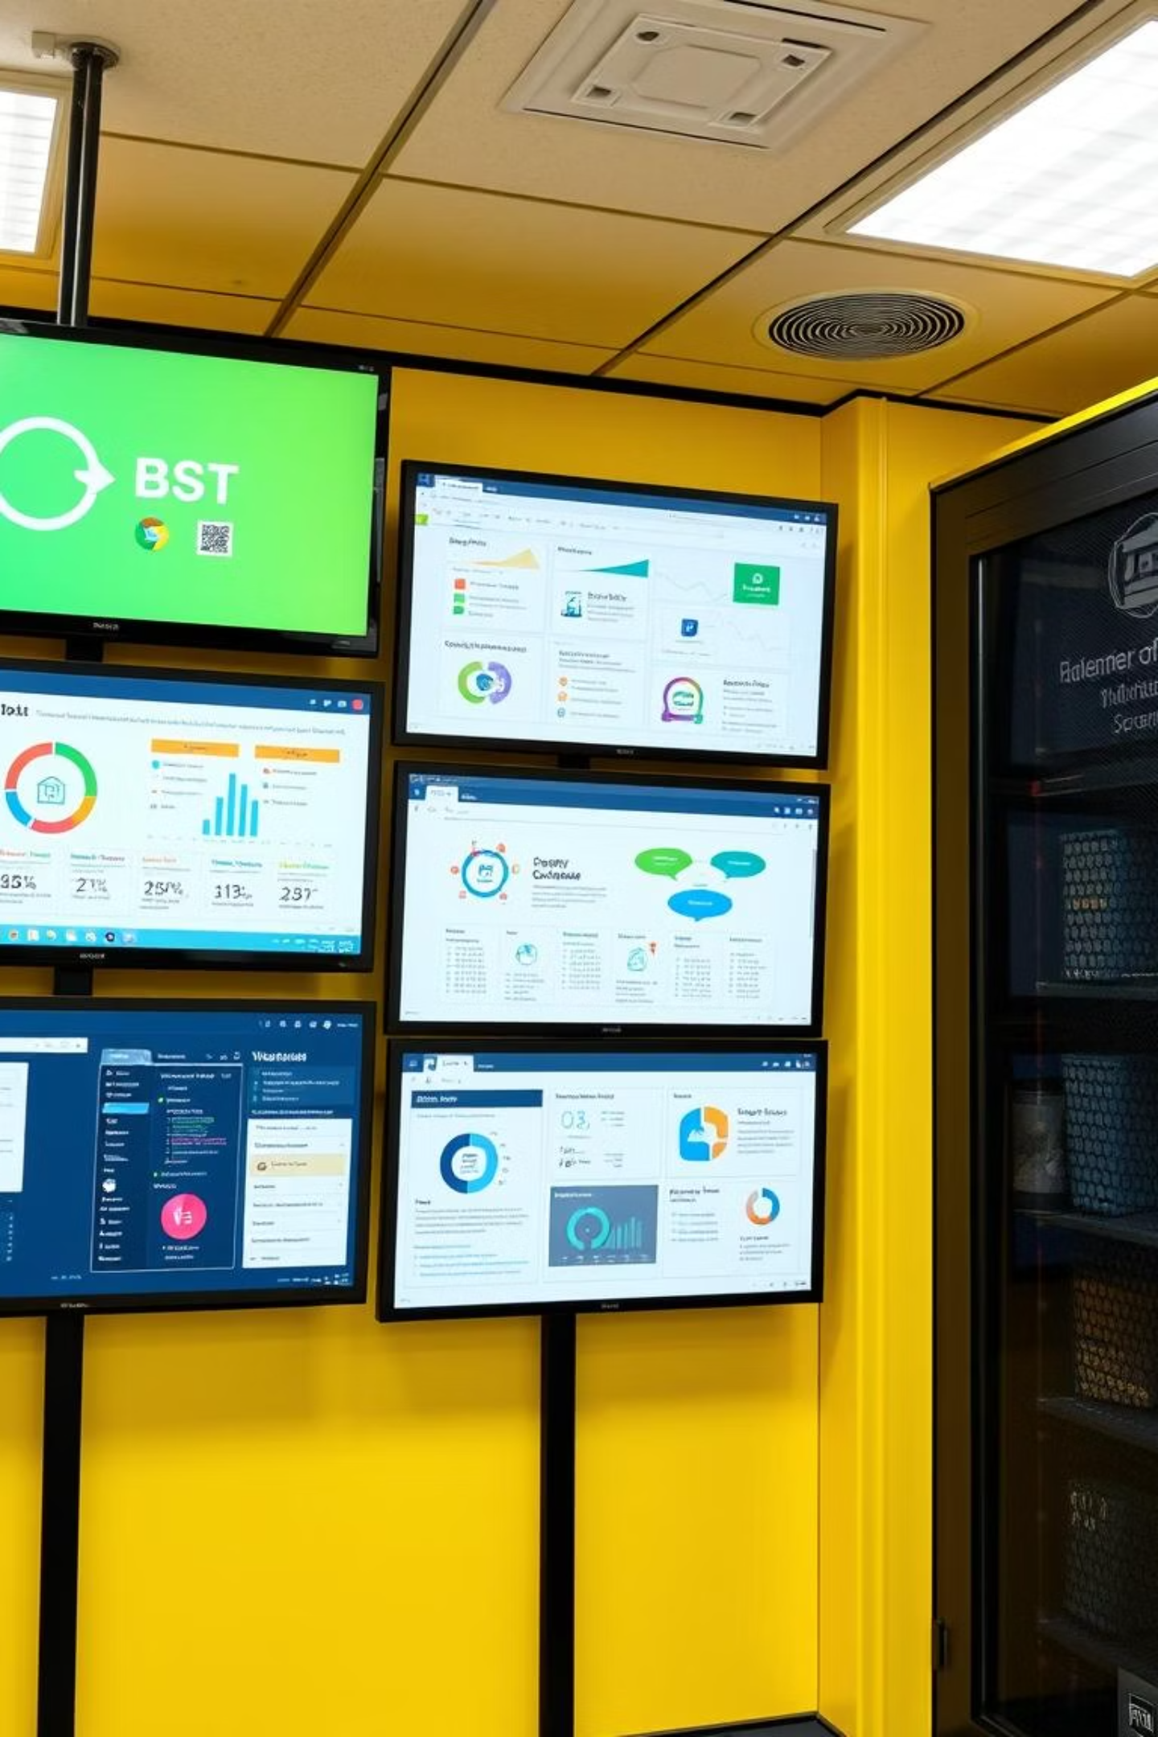
Tools and Technologies Supporting Data Governance
Data Catalogs: Centralized repositories for metadata management, making data discoverable and understandable.
MDM Systems: Master Data Management solutions for creating a single, authoritative source of critical business data.
Data Quality Platforms: Tools for profiling, cleansing, and monitoring data integrity and reliability.
Compliance Automation: Automated tools for enforcing policies and ensuring adherence to regulatory requirements.

Slide 6




Common Challenges and Solutions
Challenge: Data Silos
Solution: Collaboration
Inconsistent data definitions and fragmented information across departments.
Foster cross-functional teams and establish unified data policies.
Challenge: Data Privacy
Solution: Robust Controls
Ensuring sensitive data is protected from unauthorized access or misuse.
Implement strong access controls and continuous compliance monitoring.

Slide 7




Trends and Future Outlook
Data as a Product
AI & Automation
Shift towards treating data as a valuable, reusable product.
Integration of AI and machine learning for automated governance.
Global Regulations
Real-Time Governance
Increasing demands from regulations like GDPR and CCPA.
Emphasis on instant data observability and decision-making.

Slide 8


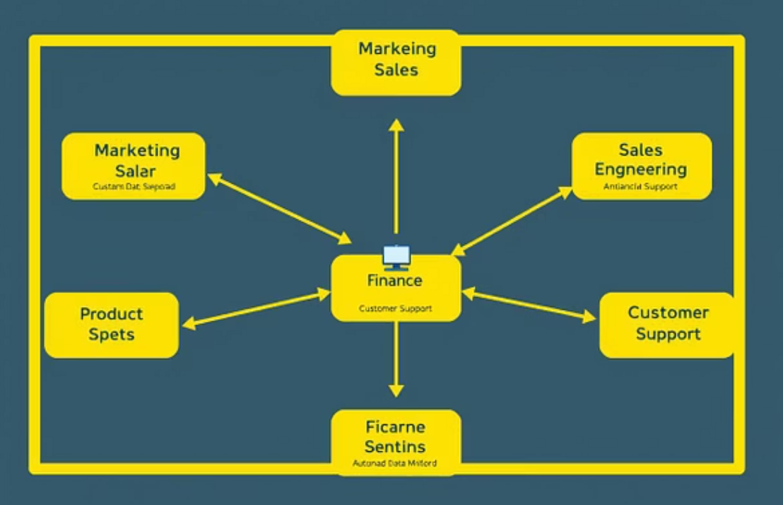
Case Study: Successful Data Governance Implementation
A leading financial institution improved data quality by 40% within a year. This led to significantly reduced compliance risks and accelerated their analytics initiatives. They achieved this by establishing clear stewardship roles, automating data monitoring, and fostering a culture of data ownership.

Slide 9
Conclusion and Next Steps
Data governance is fundamental for building trust and extracting maximum value from organizational data. It demands a unified commitment from both business and IT departments.
Start Strong
Adapt & Evolve
Define clear policies and roles.
Continuously adjust to new data landscapes.
Implement scalable tools from day one.
Embrace emerging technologies and regulations.
By proactively managing your data, your organization can unlock its full potential and navigate the future with confidence.

